Slide 1

Fortnite Ping
Tiny Seed December 2, 2019
fortniteping.com scottmckissock.gmail.com

Slide 2
Why?
Fortnite generated and estimated $2.4 billion for Epic games in 2018.
Epic’s 2019 Fortnite World Cup had a prize pool of $100 million, spread across ~19,000 players worldwide (whom we track.)
Emerging ecosystem of organizations, players and vendors needs a single place to go for information – but existing sites suck.
The name, “Fortnite Ping”: Fornite shows the “ping” (unix term) of a player in the top left corner of the screen. Having a low-latency network connection to Fortnite servers is crucial to success, and is a topic of much discussion in Fortnite circles. So this is a great, memorable name for a Fortnite site.

Slide 3
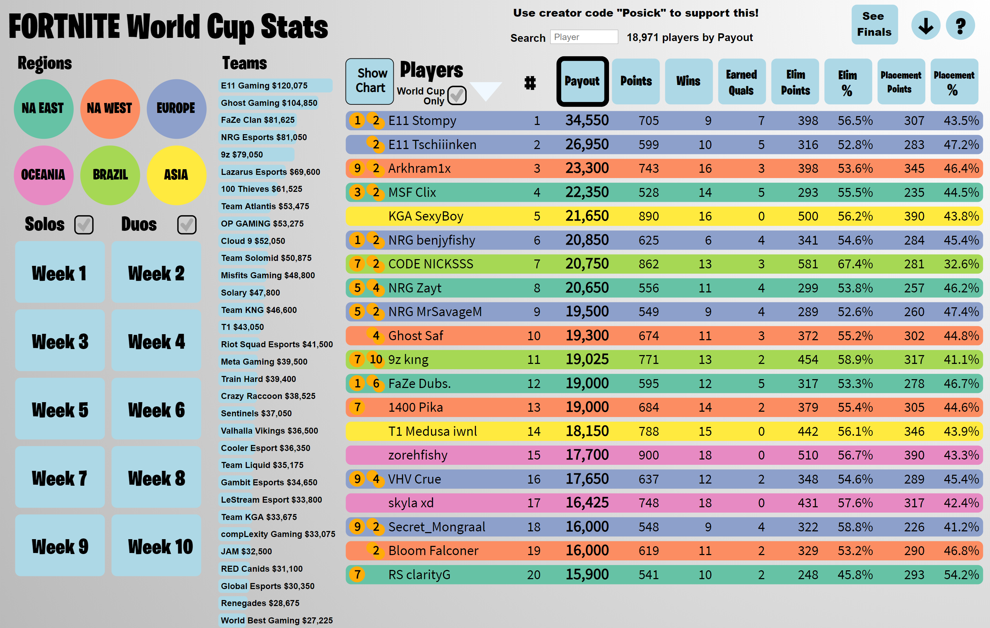
Launch
Site launched in May 2019, and covered World Cup qualifiers

Slide 4
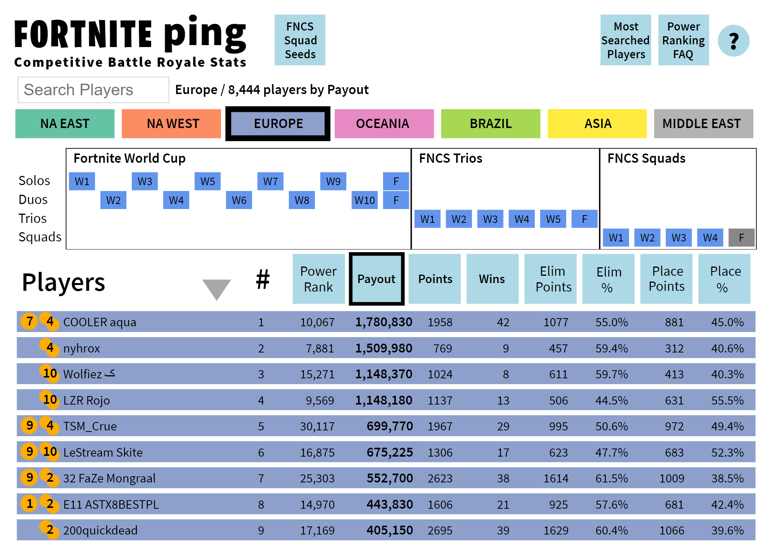
Progression
Since World Cup, expanded to cover trio and squad formats in FNCS (Fortnite Champion Series)

Slide 5
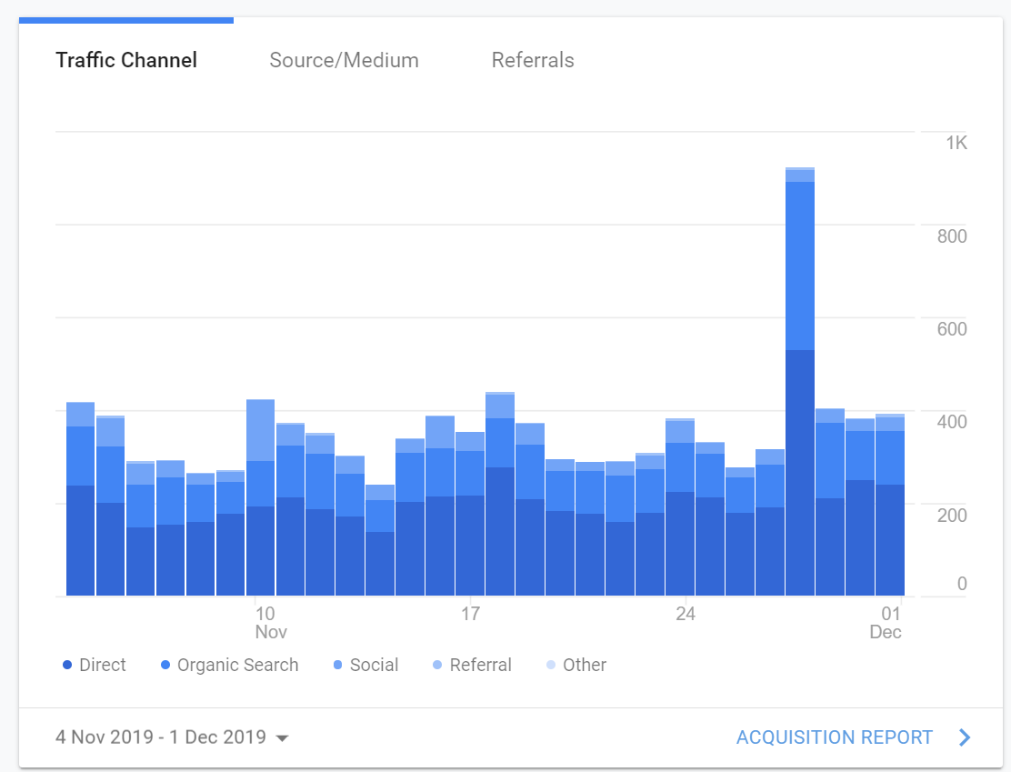
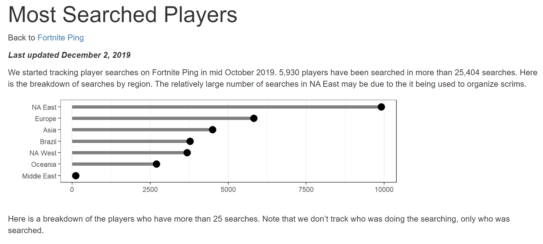
Users
300-400 unique users per day, 1000+ when there are Twitter mentions. No marketing yet.

Slide 6
Developer/Founder
Scott McKissock, dev lead at US Agency for International Development
25+ years of full stack development, plus expertise in d3.js, and R/ggplot
430 part-time hours invested in project to date.
Father of a professional Fortnite player who advises on feature prioritization for the site.

Slide 7
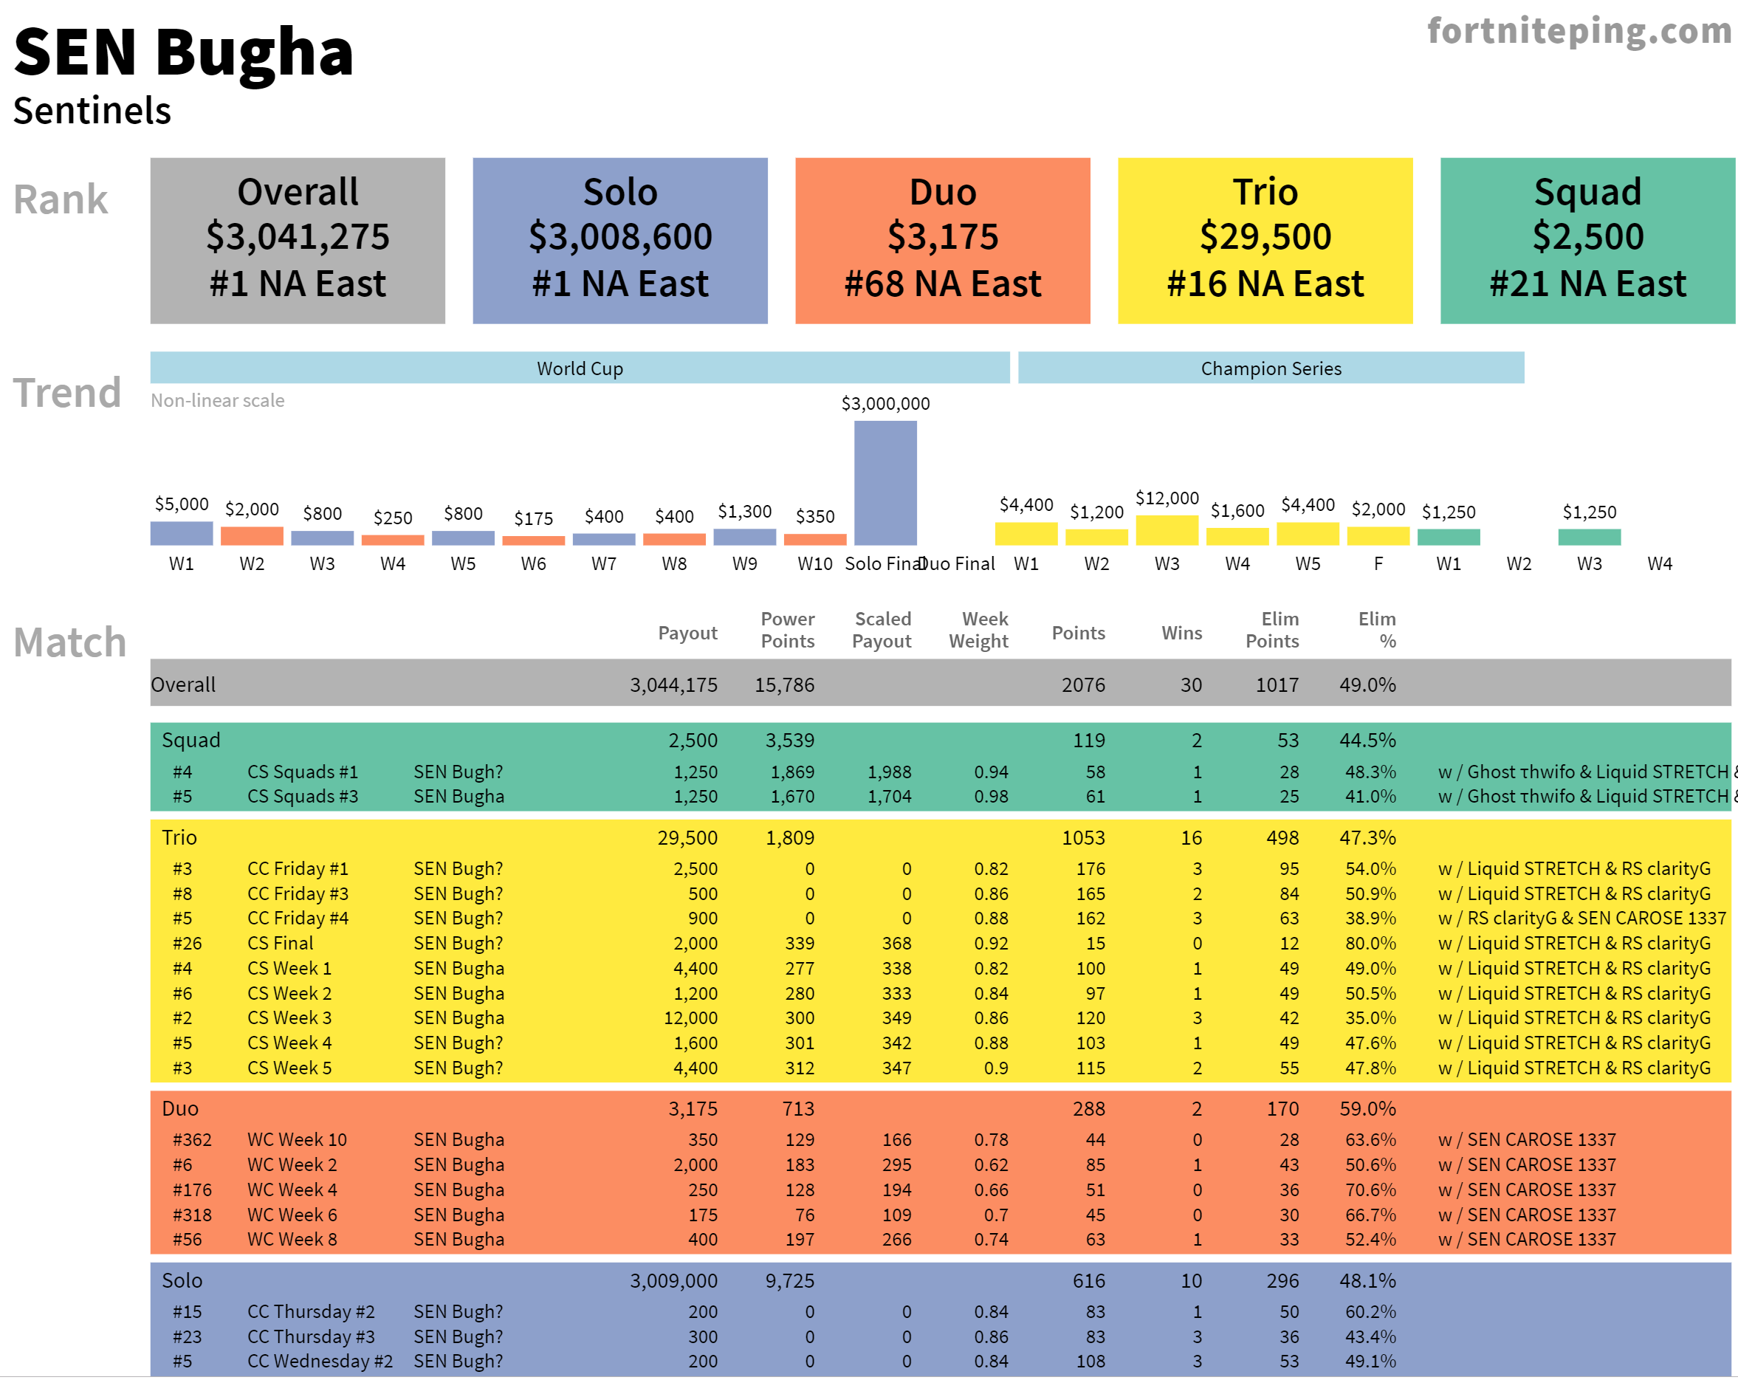
Revenue Source #1: Players
Competitive Players want to be easily recruited by orgs, and want better social media profiles. Charge a monthly fee to edit their profile page.

Slide 8
Revenue Source #2: Orgs
Charge eSport orgs monthly fees for:
1) A team page showing their current
roster, stats, news, etc.
2) Data subscriptions with the most
comprehensive player data – for recruiting
3) Display ads

Slide 9
Revenue Source #3: Sponsors
Pro players are a well-targeted market for:
1) Gaming desktops, laptops and monitors
2) Graphics cards
3) Gaming mice and keyboards
4) Network providers
5) Energy drinks, etc

Slide 10
Revenue
Until now, no attempt at revenue, just building traffic/goodwill.
Revenue Projections
 | 6 months |  |  | 1 Year |  |  | 2 Years
 | Count | Fee | MRR | Count | Fee | MRR | Count | Fee | MRR
Sponsors | 2 | 2,000 | 4,000 | 4 | 4,000 | 16,000 | 6 | 6,000 | 36,000
Organisations | 2 | 1,000 | 2,000 | 6 | 1,000 | 6,000 | 15 | 2,000 | 30,000
Players | 100 | 20 | 2,000 | 400 | 20 | 8,000 | 2,000 | 20 | 40,000
MRR |  |  | 8,000 | 30,000 |  |  | 106,000
YRR |  |  | 96,000 | 360,000 |  |  | 1,272,000
Revenue Projections
 | 6 months |  |  | 1 Year |  |  | 2 Years
 | Count | Fee | MRR | Count | Fee | MRR | Count | Fee | MRR
Sponsors | 2 | 2,000 | 4,000 | 4 | 4,000 | 16,000 | 6 | 6,000 | 36,000
Organisations | 2 | 1,000 | 2,000 | 6 | 1,000 | 6,000 | 15 | 2,000 | 30,000
Players | 100 | 20 | 2,000 | 400 | 20 | 8,000 | 2,000 | 20 | 40,000
MRR |  |  | 8,000 | 30,000 |  |  | 106,000
YRR |  |  | 96,000 | 360,000 |  |  | 1,272,000

Slide 11
Competitors
Fortnite Ping Competitors
 | URL | Collection Method | Timeliness | Compre- hensiveness | Power Rankings? | Seeds? | Player Profiles? | Team Profiles? | Revenue model(s)
Epic Competitive Website | epicgames.com/fortnite/competitive/en-US/home | Automated | Near real time | Major Events | No | No | No | No | N/A
Fortnite Tracker Network | fortnitetracker.com/events | Automated | Near real time | Major Events | No | No | Yes | Yes | Ad Network, subscriptions
Gamepedia | fortnite-esports.gamepedia.com/Power_Rankings | Crowd- sourced | Laggy, Incomplete | All events | Yes | No | Yes | Yes | Ad Network
Esports Earnings | esportsearnings.com/games/534-fortnite | Crowd- sourced | Laggy, Incomplete | All events | No | No | Yes | Yes | Ad Network
Fortnite Ping | fortniteping.com/index.html | Automated | ~ 1 day | Major Events | Yes | Yes | Yes | Not Yet | Not yet - subscriptions, ads
Fortnite Ping Competiors
 | URL | Collection Method | Timeliness | Compre- hensiveness | Power Rankings? | Seeds? | Player Profiles? | Team Profiles? | Revenue model(s)
Epic Competitive Website | epicgames.com/fortnite/competitive/en-US/home | Automated | Near real time | Major Events | No | No | No | No | N/A
Fortnite Tracker Network | fortnitetracker.com/events | Automated | Near real time | Major Events | No | No | Yes | Yes | Ad Network, subscriptions
Gamepedia | fortnite-esports.gamepedia.com/Power_Rankings | Crowd- sourced | Laggy, Incomplete | All events | Yes | No | Yes | Yes | Ad Network
Esports Earnings | esportsearnings.com/games/534-fortnite | Crowd- sourced | Laggy, Incomplete | All events | No | No | Yes | Yes | Ad Network
Fortnite Ping | fortniteping.com/index.html | Automated | ~ 1 day | Major Events | Yes | Yes | Yes | Not Yet | Not yet - subscriptions, ads

Slide 12
Tech stack
Front end: d3 & rmarkdown/ggplot
Hosting: Netlify – fast and inexpensive
Scraping: python/c#
API: c#, sql server (free version)
Team info collection: airtable, for now
Player info collection: TBD, many options
Hosting cost ~$0.00

Slide 13
Outreach, aka “growth”
- Continue making the best Fortnite leaderboards, player and team profiles & seeds.
Cultivate influencers on twitter, youtube, reddit, twitch & discord – grow traffic.
Spend money on ads? Would like to learn.
- Revenue channels reinforce each other: player and team info bring legitimacy and traffic, increasing demand for sponsor ads.

Slide 14
Why Tiny Seed?
Many improvements if not working full time – but which?
2) Multiple directions to generate revenue: need help with
prioritization.
3) Could use guidance with site metrics & social
media.
4) Paid ads or influencers? (or both)
5) Build community features?
6) Could this be a sports data journalism platform?

Slide 15
Thank You!
Fun project that keeps me connected with my kid
Would be great full time if feasible – you tell me…
Doesn’t fit your model? But I have users..?
Not exactly SAS, no revenue? – but a way to get there
Federal budgeting is a perfect background for this…
I will work on it regardless…
If no - please send some feedback!

